Slide 1
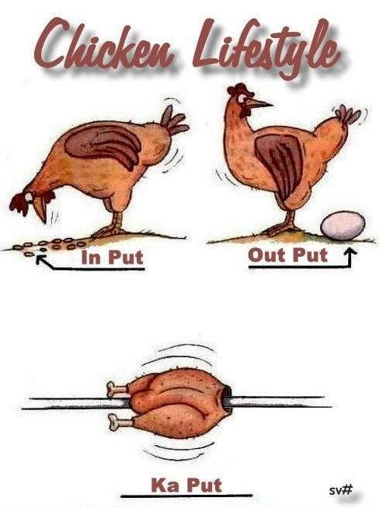
Input/output Specials
Images, audiofiles, and movies

Slide 2
Topics
Introduction: GUI and basic calculations
Coding 1: Scripts, style, and variable classes
Coding 2: Control statements and loops
Visualization 1: Basics, subplots, get and set
Coding 3: Functions
Visualization 2: Descriptive plots
Coding 4: Basic input and output
Visualization 3: Distribution and 3D plots
Coding 5: Input and output specials – last lecture before holidays
Machine Learning 1: Introduction and dimension reduction
Machine Learning 2: Clustering
Machine Learning 3: Classification
Coding 6: Efficiency and debugging basics
Coding 7: Advanced functions and debugging

Slide 3
Special Data
Imread/imwrite for image data
Images are 3D matrices ([r,g,b] color for every 2D pixel)
Audioread/audiowrite for reading audio data
Audiofiles are vectors of wav data with a specific sampling rate

Slide 4
Extra Special: Movies
movieMatrix(i) = getframe
Captures current plot axes or figureas a movie frame
Change your plot a little and save getframe all the time
movie(movieMatrix,n,fps);
Plays the movie n times at fps frames per second
VideoWriter(filename);
Quality, framerate, other adjustable
Like fopen, opens a moviefile and then writes the video, needs to be closed

Slide 5

Extra Special: Movies

